Slide 1
Azure Function 2.0

Slide 2

Agenda
What is Serverless Architecture
What is charged in Serverless vs Normal API
Various Serverless Offering
Open Source Serverless Pros and Cons
Azure function 2.0 Architecture
Azure function Uniqueness
Input output binding
How to compose Function As Service
Durable Function – Problem statement, Use case types, How it works
Logic App Vs Durable Function

Slide 3
What is Serverless Architecture
Does not mean that there is no server. It only means that you are not charged for it
Charges are incurred only for running the code + Backing services

Slide 4
What is charged in Serverless vs Normal API
PAAS
FAAS
Salient Points
LB
LB
The backing services are charged
The major change is in the host.
The host is split into two parts
Runtime:- Common for n hosts. Primary function is to manage host
Host:- Acts as a process manager for function.
Reverse Proxy
Reverse Proxy
Host server
Function Runtime
Code Units
Function Host
OS
Code Units
IaaS
OS
IaaS

Slide 5
Various Serverless Offering
Public Cloud
AWS Lambda
Azure function
Azure Durable function
Azure Logic App
Open source
Kubernetes based
Open FaaS
Riff
OpenWhisk
Container based
Open Faas
Azure Function 2.0

Slide 6
Open Source Serverless Pros and Cons
Advantages
Not stuck to one public cloud vendor
Works based on Kubernetes architecture
Well integrated to Kubernetes/Docker platform (except Azure function 2.0 and Open Faas)
Provides Open source s/w like RabbtMQ, Redis etc:-
Disadvantage
Tight coupling to Kubernetes
Day 2 operation overhead unless Managed Kubernetes cluster is used

Slide 7

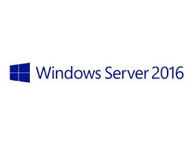


Azure function 2.0 Architecture
Language Worker
Function code
Node. js
Java
Python
.NET core
Host process
Host Runtime
.NET
(v1)
.NET Core
(V2)
Functions v2 runtime
MAC

Slide 8
Azure Function 2.0 Uniqueness
Written on .NET standard 2.0
Can run on Linux and Mac
Can run on Docker and Kubernetes
Can run on Azure environment with out any code changes
Supports Node, Python, Java, .NET, .NET scripts
Support out of box Trigger and binding
Capability of Custom Tigger and binding
Orchestration can be done using Logic App and Durable function
Durable function can handle
Long running workflow
Workflow with Human intervention

Slide 9
Input and output binding
Out of box
Blob storage
Cosmo DB
Event Grid
Event Hubs
HTTP
Microsoft Graph excel table
Microsoft Graph outlook email
Microsoft graph event
Queue Storage
Service Bus
Table Storage
Timer
Twilio
Community Supported
File
Slack output binding
SignalR
Redis
RabbitMQ

Slide 10
How to compose Azure function service
Logic app
UI Based
JSON based workflow configuration
Can be run only in Azure
Large number of pre built connector
Pre built receipes
Durable function
Code controlled
Store and Replay using Azure storage Table
Event source storage of workflow state
Can be run outside Azure

Slide 11
Durable function
Problem Statement
What if the function is not short lived, simple and stateless
What when you need a Stateful Orchestrator that is
Code Driven
Call other function state fully or stateless
Replay from a check point

Slide 12
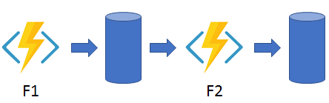
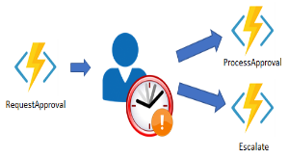

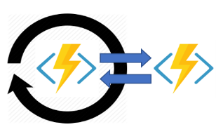
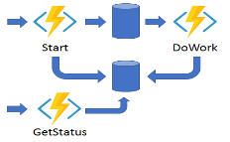
Durable function - Use case types
Function Chaining – Executing sequence of function in a predefined order
Fan-in/Fan-out – Executing multiple function in Parallel and then waiting for all to finish
Async HTTP API – It is all about the problem of coordinating long running operation with external clients
Monitoring – Flexible recurring process (ex.) until a condition is met
Human Interaction - involving humans in an automated process is that people are not always as highly available and responsive as cloud services and hence time outs needed for handling compensating transaction
1
5
Durable Function
2
3
4

Slide 13
How Durable function works
Sequence of Call
Queue
Orchestrator Function
Activity Function
Orchestration Started
Execution Started
Task Completed. Updated execution history table
Task scheduled on Activity function
?
Orchestration Completed
NO
Yes
?
Activity function Completed
Execution History
Orchestration Started
Execution completed
Orchestration Completed

